Slide 1

Identify root components of website below

Slide 2

Root div
- Height: 100vh
nav
Flex: 0
content
header
Flex: 0
Flex: 1

Slide 3
_ Main elements
nav
Flex: 0
content
Flex: 0
header
header
Flex: 1
Content

Slide 4
_ Navigation bar
Subject
Item
Profile

Slide 5


_ Navigation bar
bar
title
flex: 0
flex: 1
_ item-list
item
item
item
item
flex: 0
flex: 0
flex: 0
flex: 0
_ profile
setting
more
pf-pic
flex: 0
flex: 0
flex: 0

Slide 6
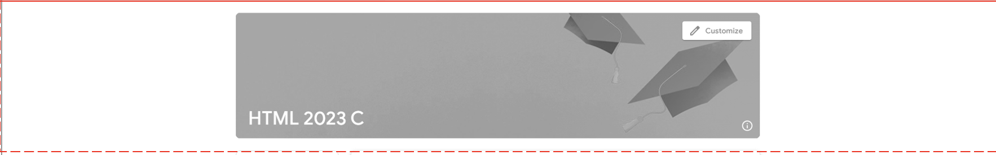
_ header
header
flex: 0

Slide 7
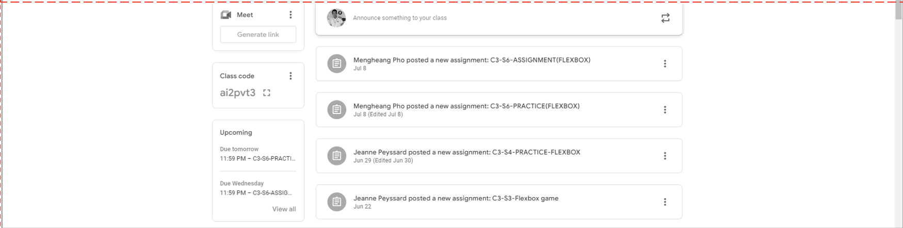
_ main
main
flex: 0

Slide 8
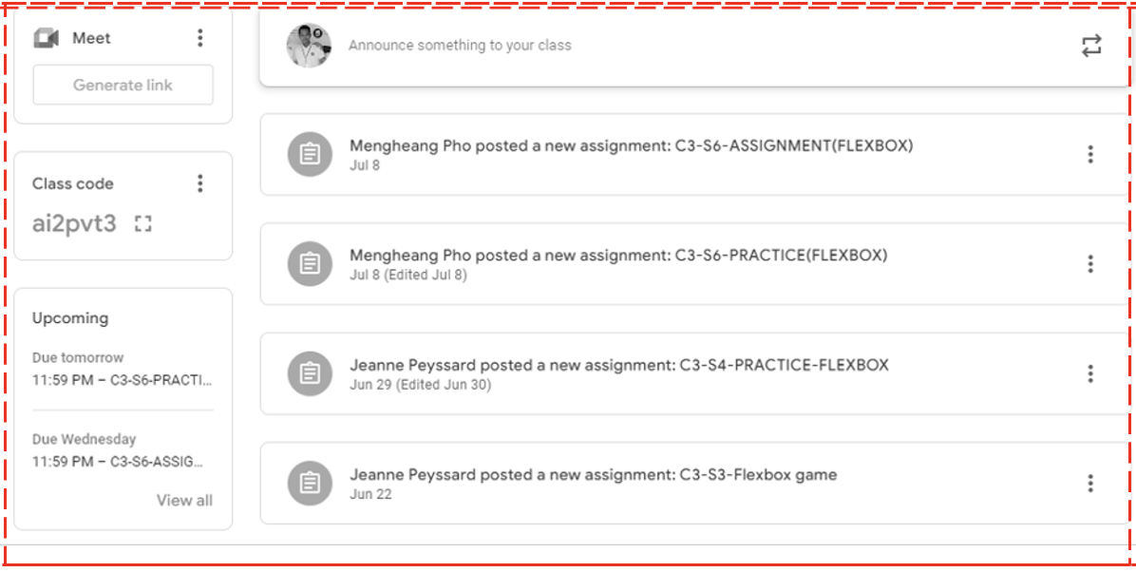
_ main-body
main-left
main-right
flex: 1
flex: 4

Slide 9
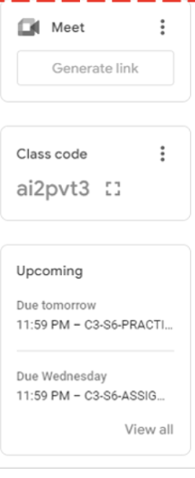
_ main-left
Icon
more
flex: 0
link
flex: 0
c-title
more
code
flex: 0
due
flex: 1
due
flex: 1

Slide 10
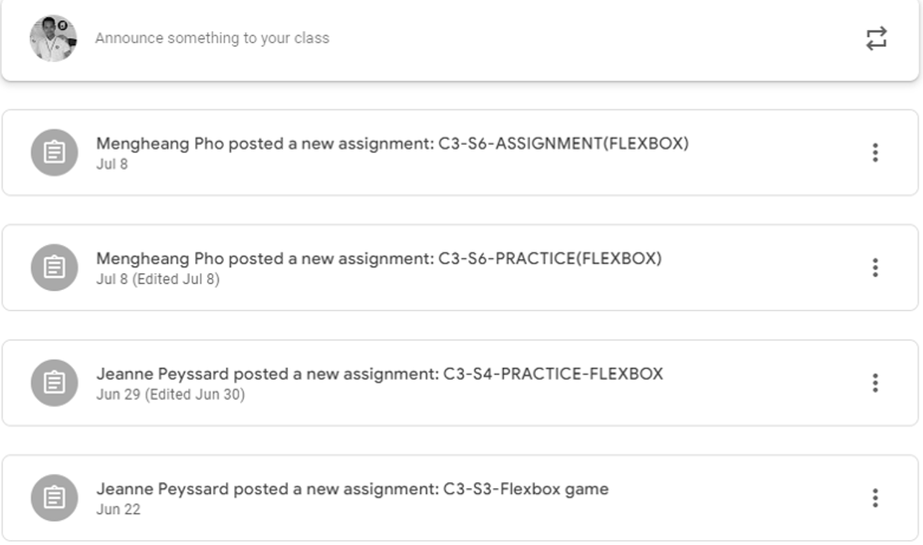
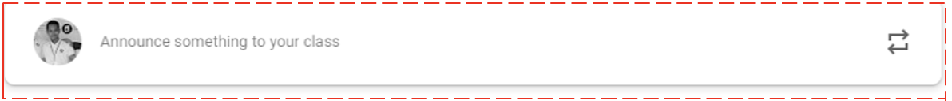
_ main-right
activity
flex: 1
announce
flex: 4
_ announce
announce-text
icon
flex: 0
flex: 0

Slide 11
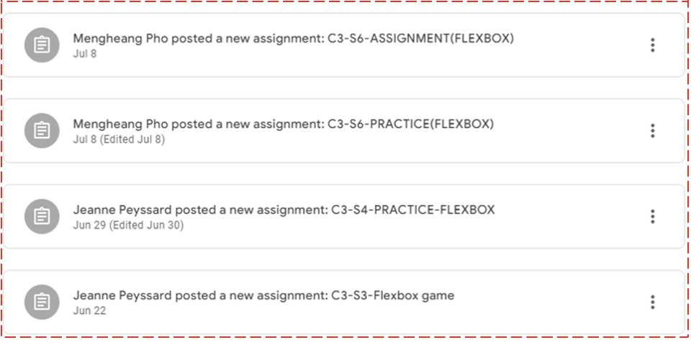
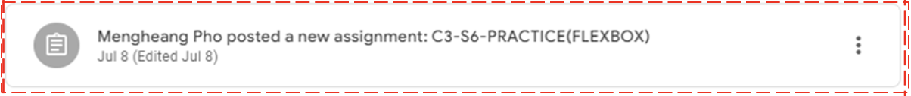
_ activity
activity-content
flex: 1
activity-content
flex: 1
activity-content
flex: 1
activity-content
flex: 1
_ activity-content
icon1
content-name
icon2
flex: 1
flex: 5
flex: 1

